Slide 1
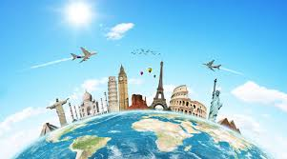
Facts and Figures
The Importance of Tourism

Slide 2
Why is tourism important?

Slide 3
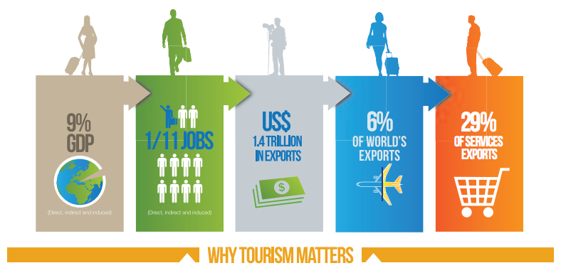
Using the infographic above above, highlight 5 reasons why tourism is an important industry

Slide 4
Activity:

Slide 5
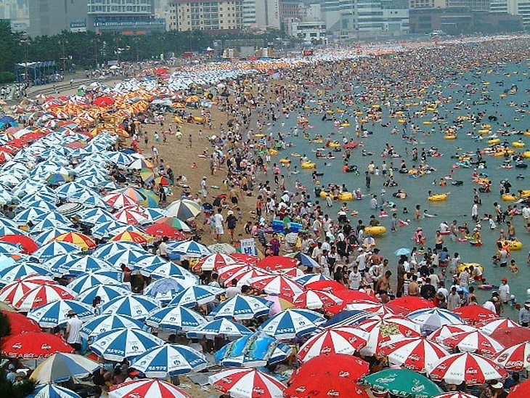
Why?
Think of at least three reasons why international tourism is growing …

Slide 6
Higher disposable income – urbanized populations
Availability of package deals and tour operators (including online)
Greater variety of choice – niche markets (medical, spas, etc)
Rapid expansion in Middle Income countries (eg. China, Singapore and Brazil)
Higher education = greater curiosity for foreign travel
Infrastructural improvements – air travel/accessibility/Wi-fi
Increase in leisure time
Development of primary and secondary tourist resources
Explaining the upward trends …

Slide 7
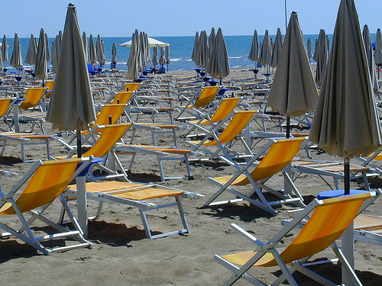
Think of at least three reasons why international tourism Might decline in the short-term …

Slide 8
Explaining possible downward trends …
Political instability (think Thailand!)
Economic recession
Increase in the costs of fuel (therefore transport)
Terrorism
Pandemics like bird flu, SARS
Extreme natural events – the Asian tsunami, the 2011 floods in Thailand

